Slide 1

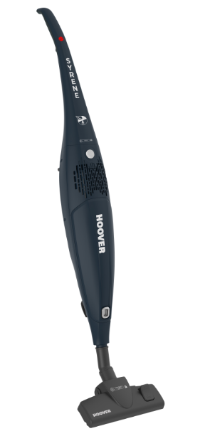



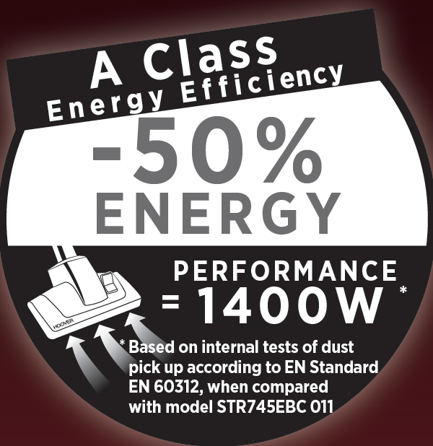



SYRENE
SR71_SR01 011
Glamor
Blue
ENERGY LABEL DATA
PURPOSE | GENERAL
ENERGY CLASS | A
PERFORMANCE ON HF | B
PERFORMANCE OF CARPET | D
DUST EMISSION | D
NOISE LEVEL (dBA) | 79
MAXIMUM WATT (W) | 700
ENERGY CONSUMPTION (KWh/year) | 27
A
CLASS ENERGY
MAIN FEATURES
Slim and lightweight
Carry handle in the back
Working radius 5m
Washable filter
Paper bag, 1.5L
All Floors Lite nozzle
CODES
MODEL NAME | SYRENE
MODEL NUMBER | SR71_SR01 011
PRODUCT CODE | 39400279
EAN CODE | 8016361933309
DIMENSIONS AND WEIGHT
PRODUCT DIMENSIONS | 257x185x1200 mm
PACK DIMENSIONS | 760x192x287 mm
WEIGHT (NET/GROSS) | 2,6 / 4,6 Kg
SLIM AND LIGHTWEIGHT
CONVENIENT
CARRY HANDLE
ALL FLOORS LITE NOZZLE

